Slide 1
TNSDC-Generative AI
LOAN PREDICTION
Presented by :HEMACHANDRAN R,
au211521104052,
Pre-Final Year Student,
Computer Science and Engineering,
Panimalar Institute of Technology.

Slide 2

OUTLINE
Problem Statement
Proposed Solution
System Approach
Algorithm
Result
Conclusion

Slide 3
PROBLEM STATEMENT
The project aims to leverage deep learning techniques, particularly Artificial Neural Networks (ANN), to develop a predictive model for estimating the probability of loan default. By analyzing historical loan data and applicant features, the model seeks to provide lending institutions with a reliable tool to assess credit risk and make informed lending decisions. The objective is to improve risk management practices, reduce the incidence of loan defaults, and enhance the overall financial stability of lending institutions.

Slide 4
PROPOSED SOLUTION
Employing Artificial Neural Networks (ANN) within deep learning, the solution entails developing a predictive model for loan prediction. By training the model on applicant data and historical loan records, it aims to identify patterns and factors contributing to loan default. Leveraging the complexity-capturing ability of ANN, the model will provide lending institutions with enhanced accuracy in assessing credit risk, thereby facilitating better decision-making and improving overall financial stability.

Slide 5
SYSTEM APPROACH
Data Collection: Gather comprehensive data on loan applicants, including financial information, credit history, employment status, and demographic details from various sources such as banks, credit bureaus, and online applications.
Data Preprocessing: Cleanse the collected data by handling missing values, outlier detection, and feature scaling. Perform feature engineering to extract relevant information and encode categorical variables for compatibility with the ANN algorithm.
Model Architecture Design: Design the architecture of the Artificial Neural Network (ANN) model, comprising input layer, hidden layers, and output layer. Select appropriate activation functions, loss functions, and optimization algorithms based on the nature of the problem and the dataset.
Model Training: Train the ANN model using the preprocessed dataset. Utilize techniques such as mini-batch gradient descent and backpropagation to optimize the model's parameters iteratively. Monitor training progress and adjust hyperparameters as necessary to improve performance.

Slide 6
SYSTEM APPROACH – CONT.
Model Evaluation: Evaluate the trained model using performance metrics such as accuracy, precision, recall, and F1-score on a separate validation dataset. Conduct cross-validation to ensure the model's generalization ability and assess its robustness.
Deployment and Integration: Deploy the trained ANN model into the lending institution's existing loan approval system or as a standalone application. Integrate the model into the decision-making process, allowing loan applications to be automatically assessed for credit risk.
Monitoring and Feedback Loop: Continuously monitor the performance of the deployed model in real-world scenarios. Collect feedback from loan approval decisions and customer outcomes to refine the model further and improve its predictive accuracy over time.

Slide 7

ALGORITHM
Data Preprocessing:
Cleanse the dataset by handling missing values, outliers, and noise.
Encode categorical variables into numerical representations.
Normalize or standardize numerical features to ensure uniform scale.
Split Data:
Divide the preprocessed dataset into training, validation, and testing sets.
ANN Model Architecture:
Design the architecture of the Artificial Neural Network (ANN) model.
Define the number of input nodes corresponding to the features and output nodes representing the loan approval decision.
Determine the number of hidden layers and nodes, along with activation functions for each layer.
Choose appropriate loss function, optimizer, and metrics for model training.
Model Training:
Feed the training data into the ANN model and adjust the model's parameters iteratively to minimize the loss function.
Utilize backpropagation algorithm to propagate errors backward through the network and update weights accordingly.
Employ techniques such as mini-batch gradient descent to optimize the learning process.
Model Evaluation:
Validate the trained model's performance on the validation set to prevent overfitting.
Evaluate the model's accuracy, precision, recall, F1-score, and other relevant metrics.
Adjust hyperparameters if necessary based on validation results.

Slide 8
ALGORITHM - CONT.
Prediction and Decision-making:
Utilize the trained ANN model to make predictions on new loan applications.
Threshold the prediction probabilities to classify loan applications as approved or rejected.
Incorporate the model's predictions into the lending institution's decision-making process, considering risk tolerance and business objectives.
Model Deployment:
Deploy the trained ANN model into production, either as part of an existing loan approval system or as a standalone application.
Ensure scalability, reliability, and efficiency of the deployed model to handle real-time prediction requests.
Monitoring and Maintenance:
Continuously monitor the performance of the deployed model in production.
Collect feedback data on model predictions and loan outcomes to identify potential issues or areas for improvement.
Generator Layers
Discriminator Layers

Slide 9
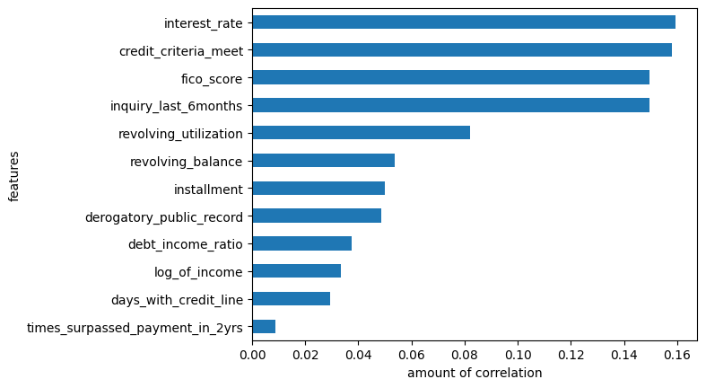
RESULT
9

Slide 10
Conclusion
In conclusion, leveraging the ANN algorithm for loan prediction offers a potent tool for lending institutions to enhance risk assessment accuracy and streamline decision-making processes. By harnessing the intricate patterns within loan applicant data, ANN models can effectively forecast the likelihood of loan defaults, empowering lenders to mitigate financial risks and optimize loan approval workflows. However, successful implementation necessitates meticulous data preprocessing, rigorous model training, and ongoing performance monitoring. Through the strategic adoption of deep learning techniques, lending institutions stand to bolster operational efficiency, reduce default rates, and foster financial stability. Embracing ANN-based loan prediction represents a pivotal step toward harnessing advanced analytics and artificial intelligence for informed decision-making, ultimately benefiting both lenders and borrowers in the financial landscape.
10

